Slide 1
Movie Recommendation System
Popcorn Predictors - Team #2
PRESENTED BY:
Santiago Benheim, Cherron Griffith, Ethan Iwama, Eren Kaval, Meghna Sharma, Patrick Wang
04/30/2025

Slide 2
About…
Goal: Recommend movies using user preferences and movie metadata
Dataset: TMDB 5000 Movie Dataset
Techniques:
Principal Component Analysis
Random Forest
K-Nearest Neighbor Models
Tools:
Exploratory Data Analysis (EDA):
Data Cleaning (pandas & numpy)
JSON parsing for structured metadata
Column Selection (PCA)
Visualization (seaborn & matplotlib)
Machine Learning:
One-Hot Encoding/TF-IDF Vectorization
Cosine Similarity KNN
Euclidean/Manhattan Distance KNNs

Slide 3
Part 1: Data Exploration and Feature Analysis
01
Preparation for Data Training

Slide 4
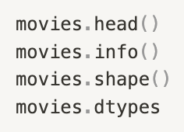
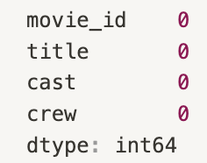
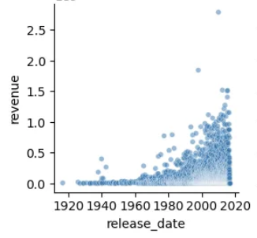
Data Cleaning
0 1 .
Corrected column data types and extracted relevant values from columns containing lists of Python dictionaries
0 2 .
Handled missing values by ensuring they were properly represented according to the column data type, without discarding too much data
Exploratory Data Analysis (EDA) was conducted on both datasets to identify missing values, correct column data types, and uncover significant relationships relevant to our project goal.
0 3 .
Refined the dataset to include only columns relevant to our project
0 4 .
Created visualizations to uncover significant relationships within the data

Slide 5
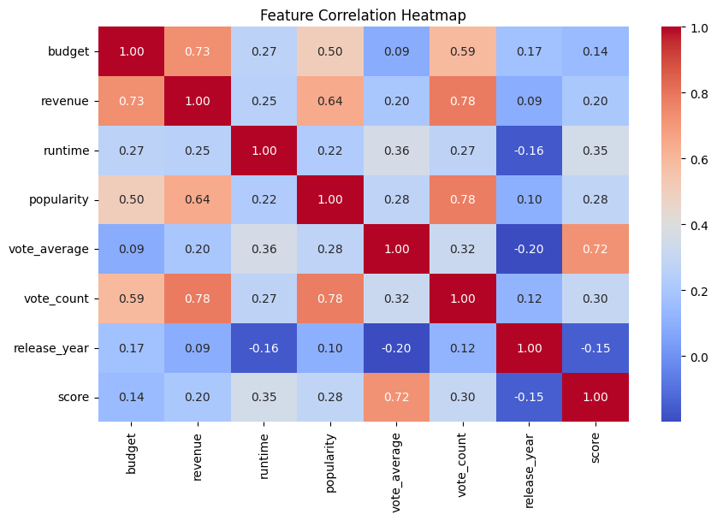
Scoring Function
Created a scoring function similar to the scoring metric of IMDB
considers both vote_average and vote_count
Filtered out for the 95th percentile of vote_counts
excludes movies with low vote_counts
filled missing scores with 0
Added score column to dataframe to be used for analysis

Slide 6
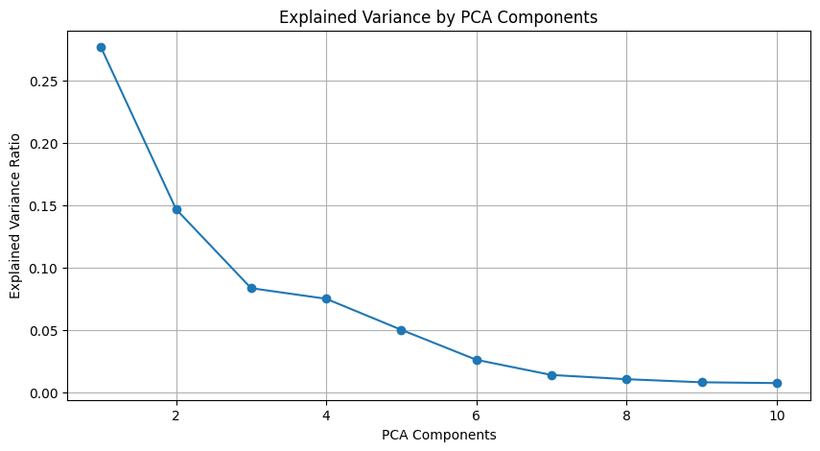
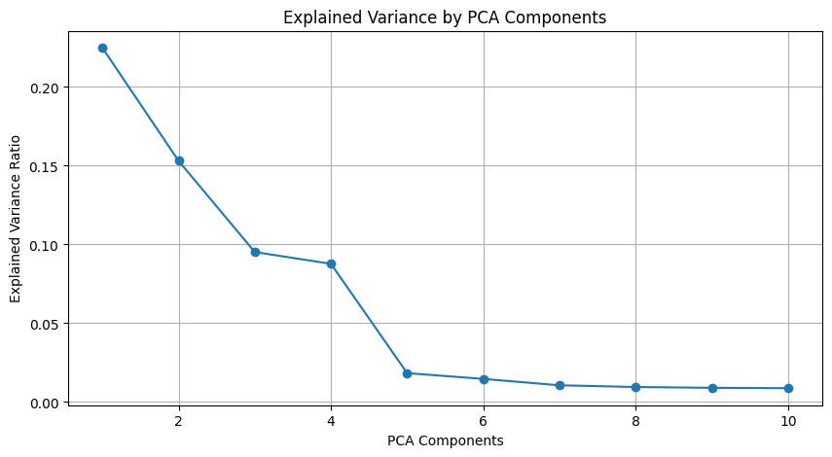
Data Preprocessing
Converted categorical columns to numerical format
One Hot Encoding was used on language
TF-IDF Vectorization was used on genres, keywords, directors, and actors
Performed Principal Component Analysis (PCA) after standardizing to identify features that explain the most variance within the data
Reduced dimensionality for improved computational efficiency and model performance
2 different PCA sets
First plot: With Revenue and Budget: Explains 70 % of variance
Second plot: Without Revenue and Budget:
Removed after Feature Relevance test with Score metric: Explains 63% of variance

Slide 7
Part 2: Recommendation Model Development
02
Evaluating Different Recommendation Models

Slide 8
Recommendation Models
Cosine Similarity:
Measures the cosine of the angle between two vectors
Implemented K-Nearest Neighbors (KNN) using 3 distance metrics:
configured these models to recommend the top 5 similar movies
Euclidean Distance:
Calculates the straight-line distance between two vectors
Manhattan Distance:
Computes the sum of absolute differences across dimensions

Slide 9
Simulation Scenarios
Each model’s accuracy metrics were tested using simulated users in three watch history scenarios:
Each user has randomly selected movies in their history
Each user has randomly selected high-scored (score > 7.0) movies in their history
Each user has randomly selected non-English movies in their history
Each user is recommended 5 movies
For each user, the recommended movies relevancy is determined
Precision, Recall, F1, and MAP are determined based on how many recommendations are relevant
Metrics are found for each user, then averaged for each scenario
Notes:
Movies are relevant if: Its score is above (mean of watched scores − 2 standard deviations) and It shares at least 25% of its genres with the user's watched genres.

Slide 10
Model Accuracy
A recommendation is determined relevant if:
Its score is above the score threshold
It shares ≥25% of its genres with the user’s watched genres
Score threshold is determined using the mean and standard deviation of the user’s watch history:
Mean - 2*(Standard Deviation)
Metrics were determined understanding:
True Positives were relevant movies recommended
False Positives were non-relevant movies recommended
False Negatives were relevant movies in the entire dataset not found in recommendations
Notes:
Movies are relevant if: Its score is above (mean of watched scores − 2 standard deviations) and It shares at least 25% of its genres with the user's watched genres.

Slide 11
Part 3: Results and Visualizations
03
Conclusions and Future Work

Slide 12
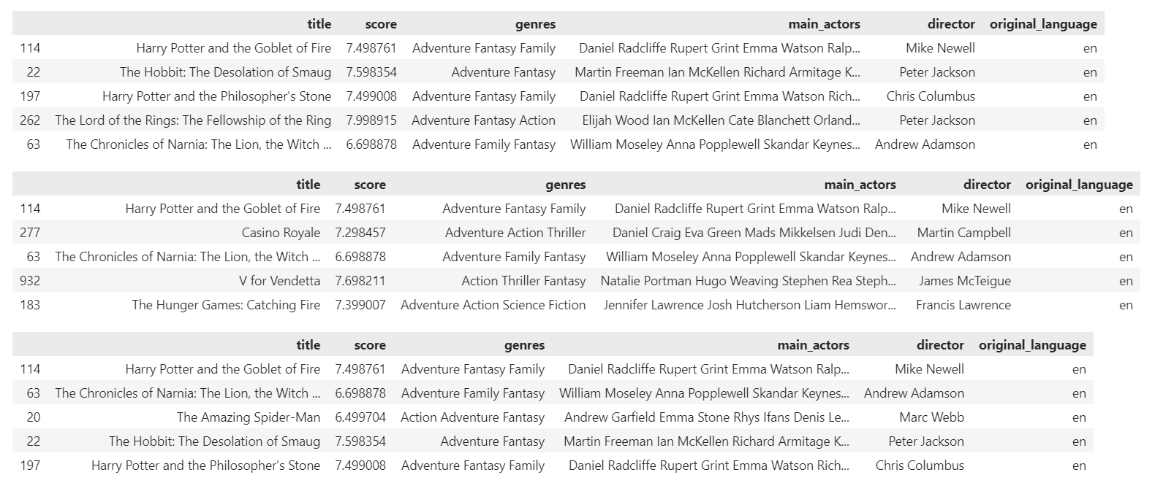
Example Recommendations:
Cosine
Euclidian
Manhattan

Slide 13
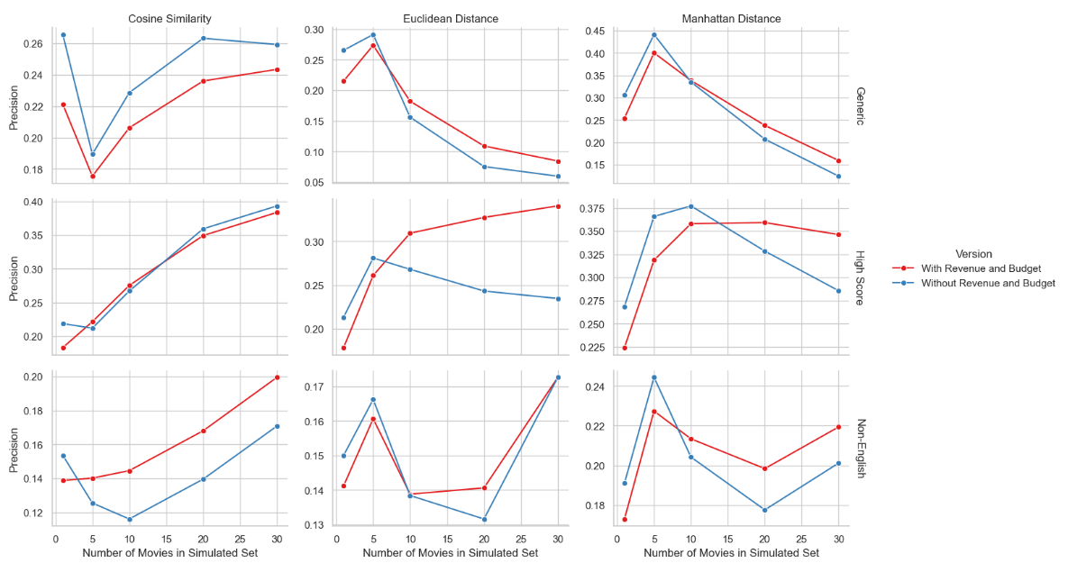
Precision

Slide 14
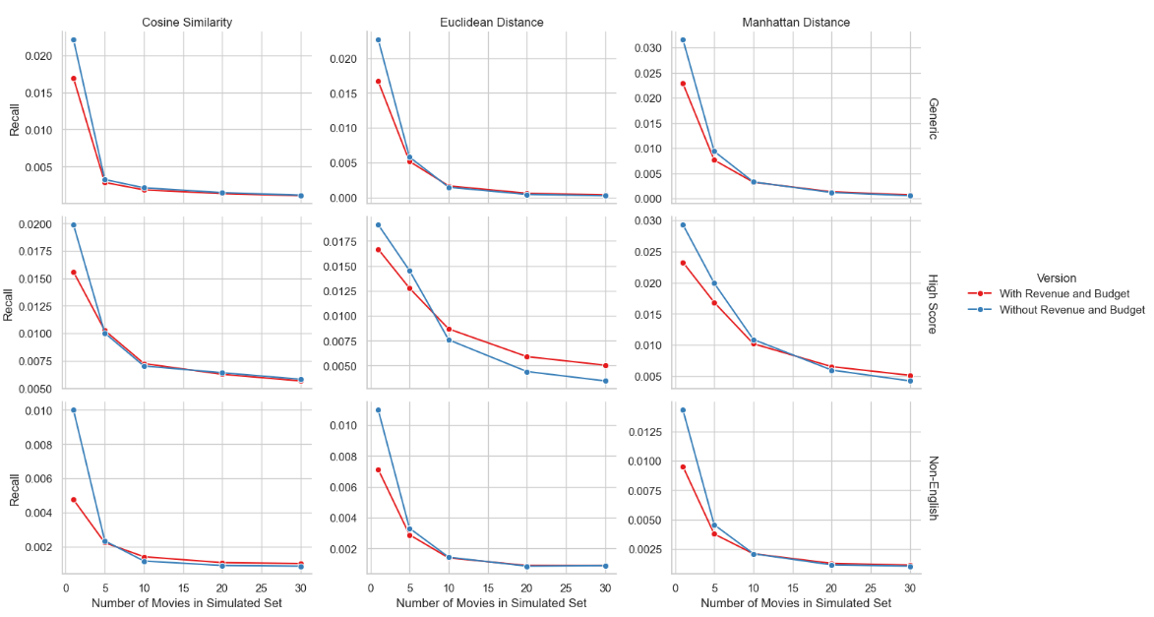
Recall

Slide 15
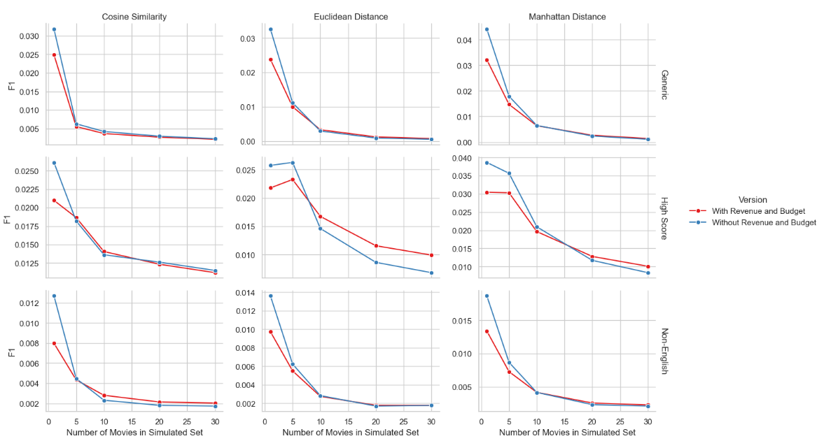
F1

Slide 16
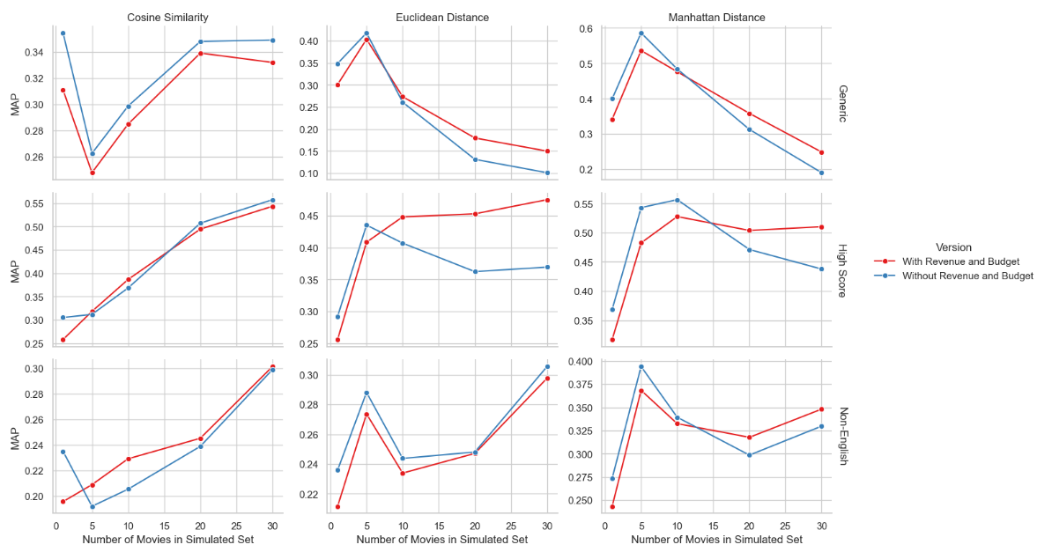
Mean Average Precision

Slide 17
Thank You!
Popcorn Predictors - Team #2
PRESENTED BY:
Santiago Benheim, Cherron Griffith, Ethan Iwama, Eren Kaval, Meghna Sharma, Patrick Wang
04/30/2025

